Slide 1

ONLINE SURVEY SYSTEM
Yash Umredkar 20104012
Disha Phatta 20104029
Abhishek Shinde 20104007
Snehi Ratani 20104035
Project Guide
Ms. Yaminee Patil

Slide 2
Contents
Introduction
Objectives
Scope
Features / Functionality
Project Outcomes
Technology Stack
Block Diagram if applicable

Slide 3
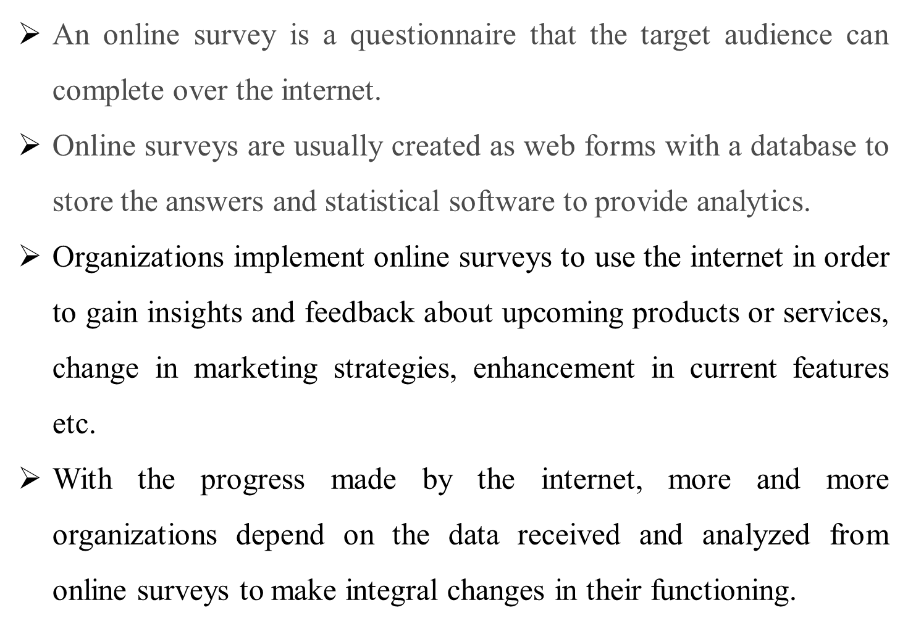
1. Introduction

Slide 4
2. Objectives
To study the customer satisfaction level for the company Qvoid.
To analyse complaints of customers towards products and services.
To analyse complaints of customers towards products and services.
To find out the customer interest for the company’s products

Slide 5
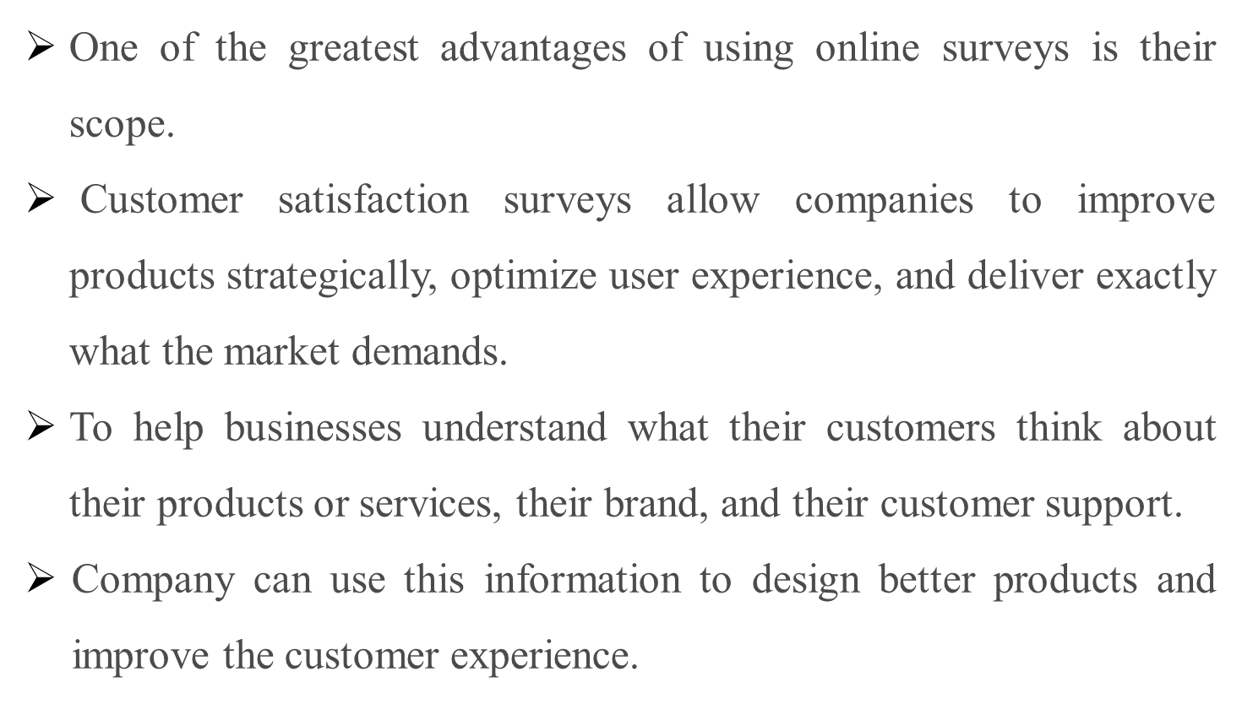
3. Scope

Slide 6
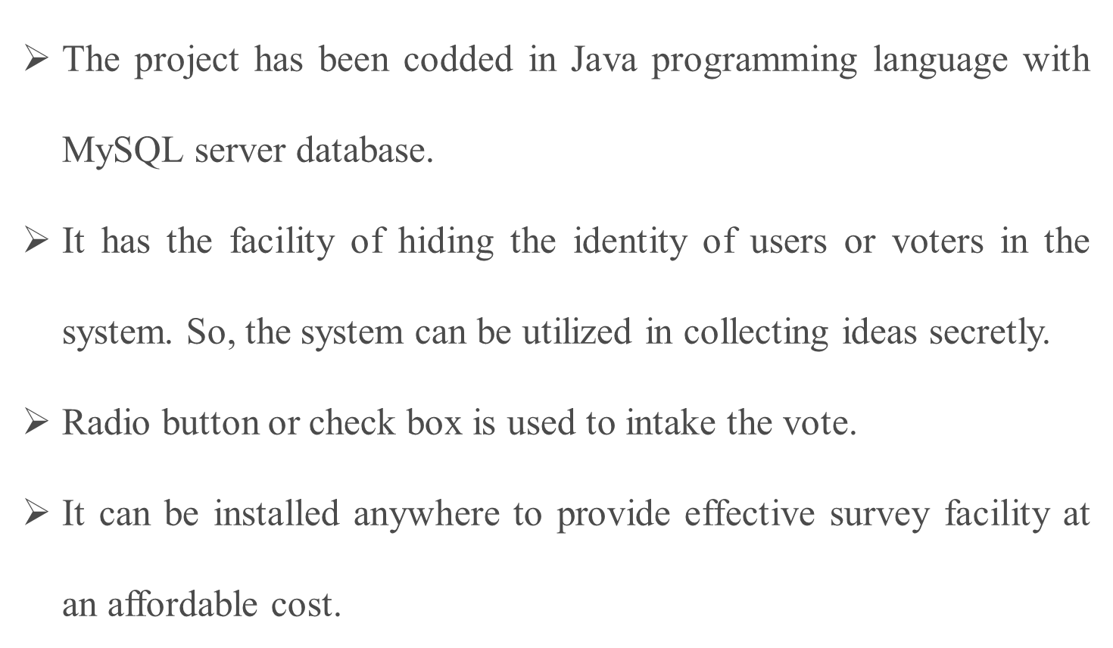
4. Feature /Functionality

Slide 7
5. Outcome of Project
Customer can login, and admin or host can create questionnaire of any products for our customers.
A well designed layout of product page where customers can click on any images to attempt the survey of particular product
It can identify opportunities for product and service innovation.
It can ensure the quality improvement efforts are correctly focused on issues that are most important to a customer.

Slide 8
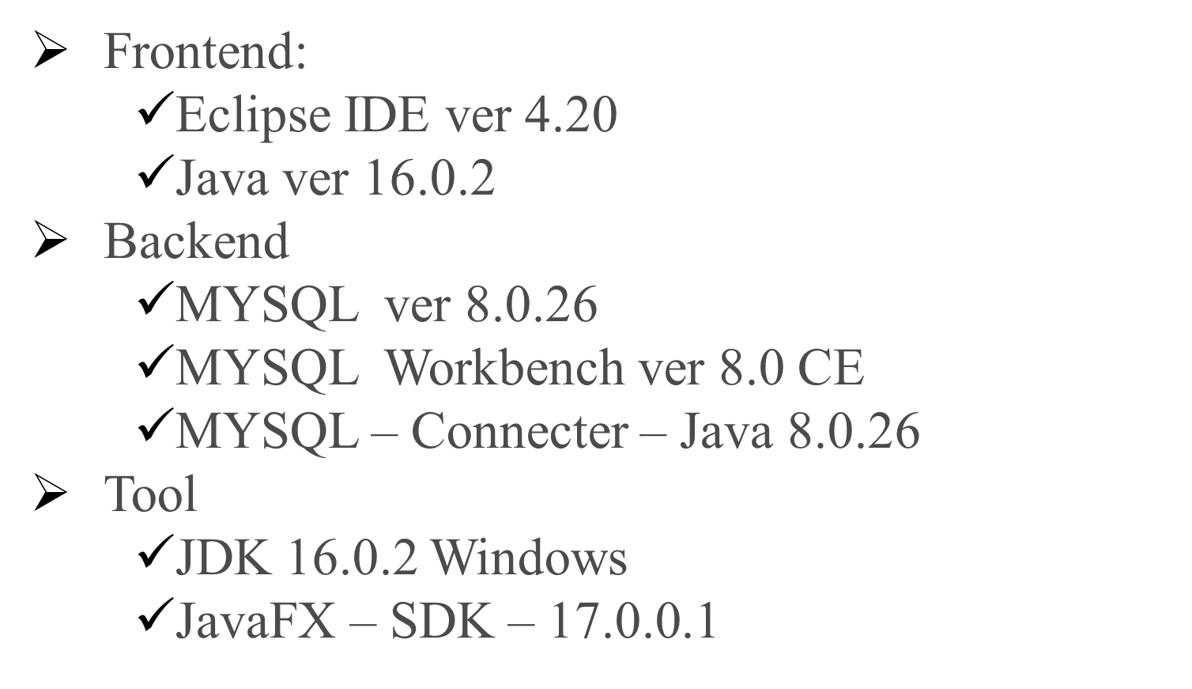



6. Technology Stack

Slide 9







7. Block Diagram
User
Management
Create Survey
Management
Survey ID
Management
Survey
Management
System
Register
Management
Questions
Management
User Response
Management

Slide 10
Thank You...!!

